Slide 1


Group w NYC taxi data
Jae Ham & Andrew Thvedt

Slide 2
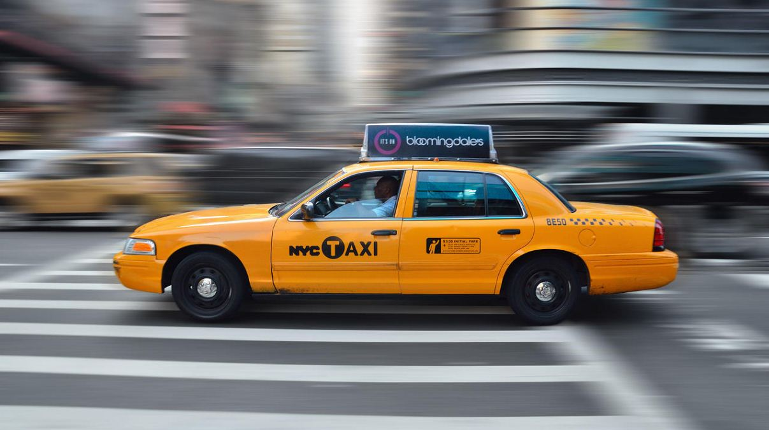
Project Rationale
NYC Yellow Cab 2019 Data
Derived from TLC Website
Exclusive focus on yellow cabs
Year 2019
Preprocessing Data Steps
Stage 1
Subsetting Data
Stage 2
Scrubbing Data
Stage 3
Final Processing
100,000 data points per month
Rate Code ID
Passenger Counts
Fare Amount
Fare By Distance
Avg MPH
Dealing with time data
Negative or infinity values
Quality Check

Slide 3
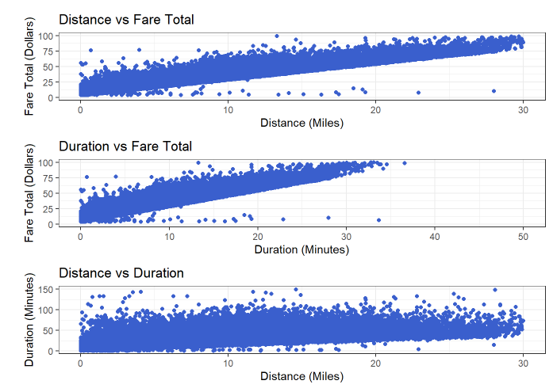
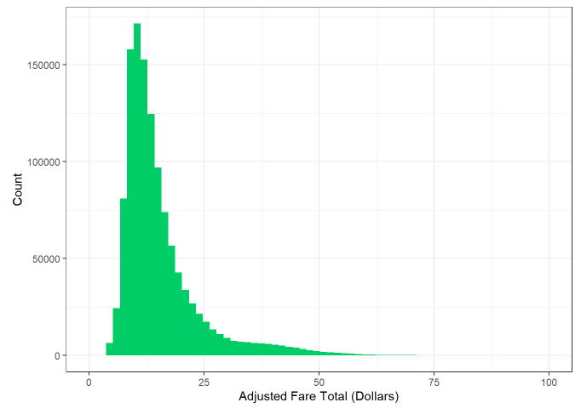
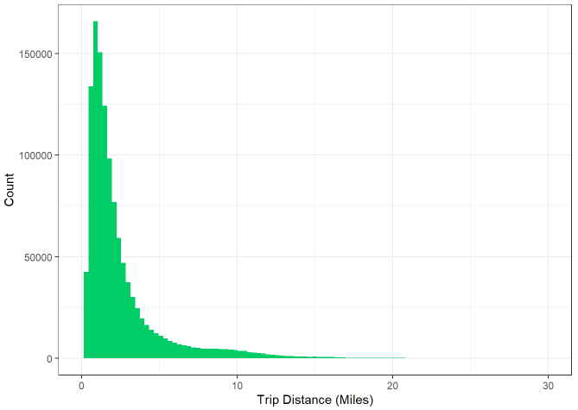
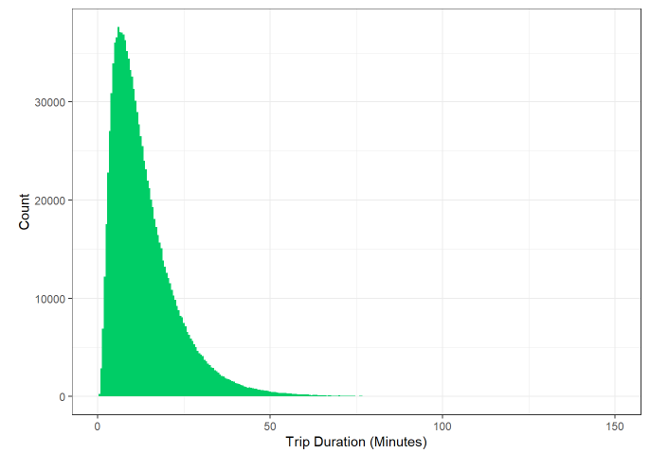
Exploratory Data Analysis
Univariate Analysis
Bivariate Analysis

Slide 4
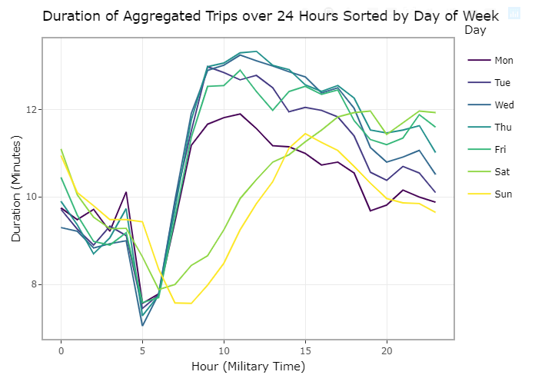
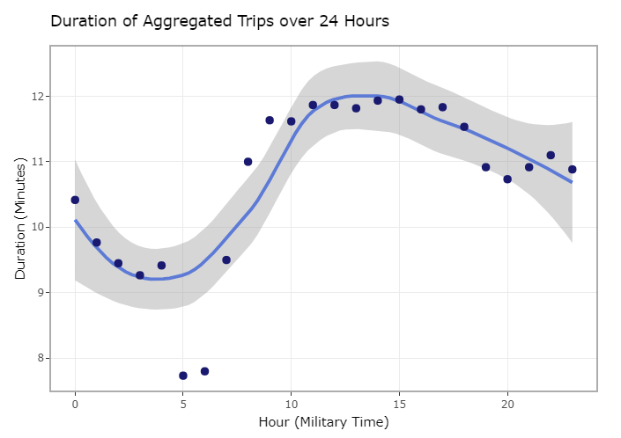
Time Series Analysis

Slide 5
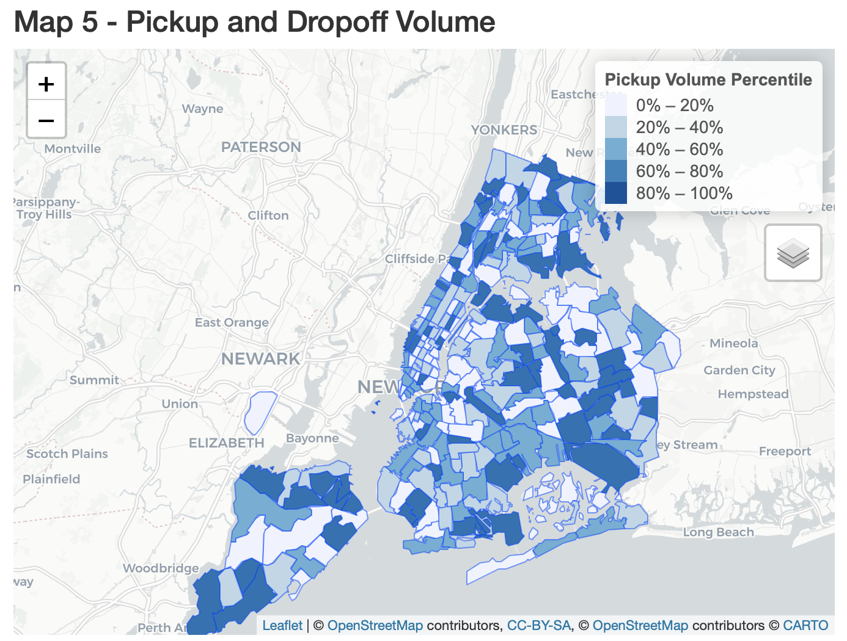

Maps
Maps effectively display different types of information than other types of plots
Geographic in nature, ideal for patterns across zones
Aggregated by:
Pickup or dropoff location
Within zone trips

Slide 6
Conclusions
High dataset quality from NYC
Developed familiarity with Taxi data and dataset issues
Visualizations reveal interesting patterns, confirm conventional wisdom
Plots and maps both have unique strengths to highlight aspects of data
Reinforced visualization best practices
Experience implementing and integrating multiple types of visualizations
Continue working with dataset

Slide 7

Next Steps
Integrate with SQL, Google BigQuery to work with full NYC Taxi Data
Host code online (Amazon)
More user interactivity, dynamically load data and create output as necessary
Apply machine learning models

